Slide 3
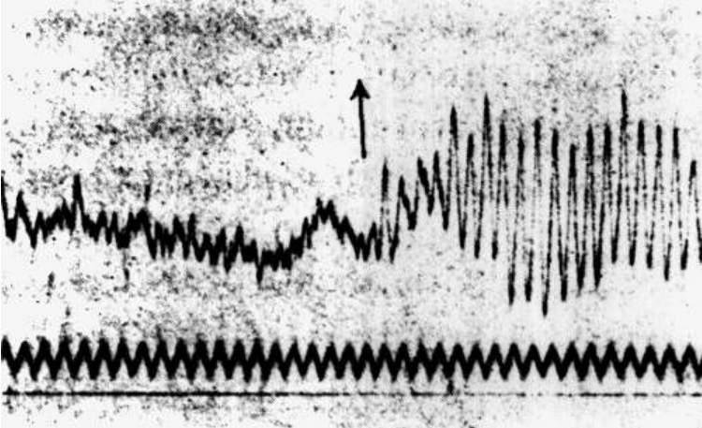
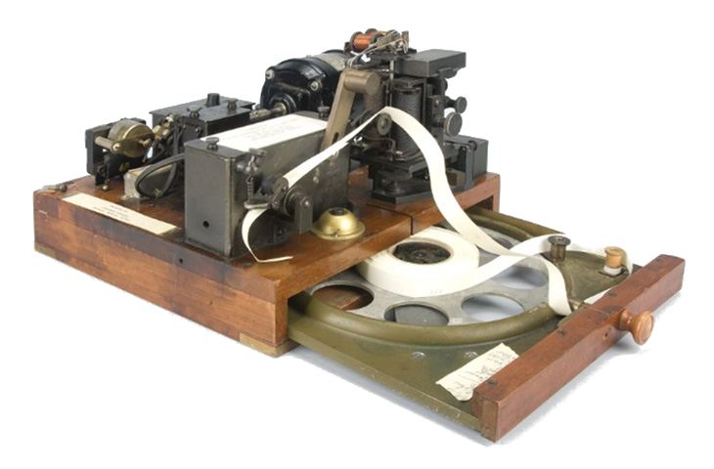
99 years ago…

Slide 4
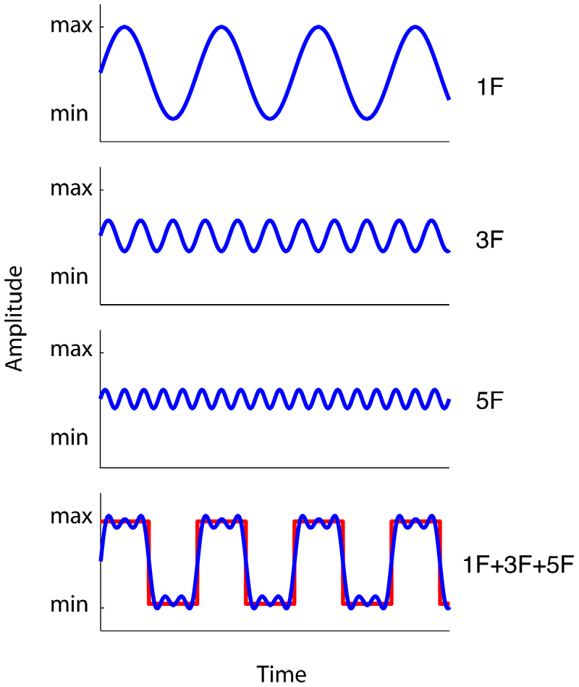
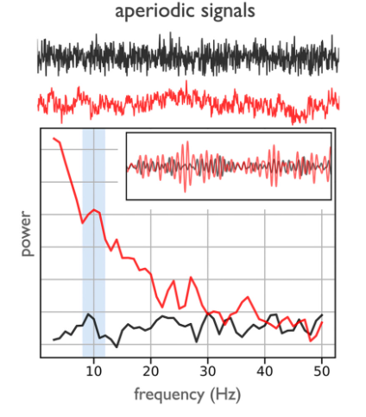
Caveats when studying neural oscillations
Donoghue, T., Schaworonkow, N., & Voytek, B. (2022). Methodological considerations for studying neural oscillations.
Van der Burg, E., Cass, J., Olivers, C. N., Theeuwes, J., & Alais, D. (2010). Efficient visual search from synchronized auditory signals requires transient audiovisual events.

Slide 5
Caveats when studying neural oscillations
Topic | Data properties | Methodological issues | Recommendation
#1 Oscillation presence | Neural oscillations are variably present, and may not be present in the recording | If there are no oscillations, applied measures will not reflect oscillatory activity, but will return a value reflecting aperiodic activity | Verify the presence of an oscillation, such as with spectral peak detection or with burst detection in the time domain
#2 Frequency variation | Neural oscillations have variable peak frequencies | Measures applied using canonically defined frequency bands may fail to accurately capture oscillatory activity | Verify frequency ranges and individualize as needed
#3 Aperiodic activity | Neural oscillations co-exist with dynamic aperiodic activity | Measured variation may arise due to changes in aperiodic activity, rather than changes in oscillations | Measure and control for changes in aperiodic neural activity, evaluating whether it explains measured changes
#4 Temporal variability | Neural oscillations are variable across time, exhibiting burst-like properties | Burst properties may be conflated when analysing spectral power, and trial averages may suggest illusory sustained activity | Examine single trial data for temporal variation, and use burst detection to evaluate burst properties
#5 Waveform shape | Neural oscillations have non-sinusoidal waveform shape | Analysis methods often assume sinusoidal structure, and may return spurious results in the case of non-sinusoidal oscillations | Examine waveform shape measures to evaluate if waveform shape may underlie the results
#6 Overlapping oscillations | Multiple neural oscillations co-exist across the brain, and may overlap across space | Multiple distinct sources may create destructive interference, in which case measures will not accurately reflect underlying activity | Apply source separation techniques in order to reduce overlap of different types of oscillations
#7: Signal-to-noise ratio | Neural oscillations have variable signal-to-noise ratio | Without adequate signal to noise ratio, measures may be unreliable or inaccurate | Evaluate the required signal-to-noise ratio, and potential ways to optimise it for all applied measures
Donoghue, T., Schaworonkow, N., & Voytek, B. (2022). Methodological considerations for studying neural oscillations.

Slide 6
Tools to unmix periodic and aperiodic activity
FOOOF | eBOSC | IRASA
(fitting oscillations and 1/f) | (extended better oscillation detection) | (irregular-resampling auto-spectral analysis)
2020 | 2020 | 2016

Slide 7
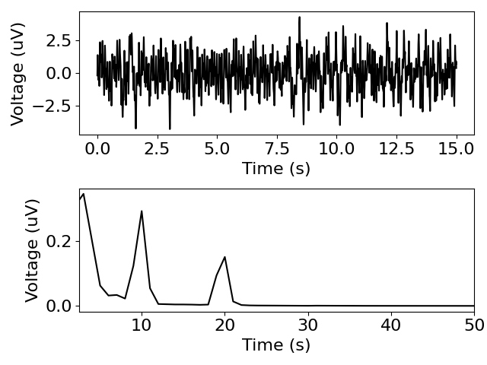
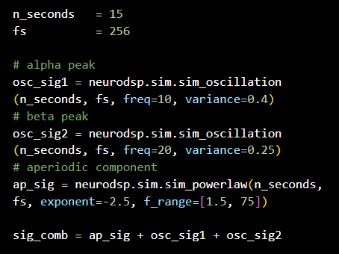
Visual comparison of algorithms

Slide 8
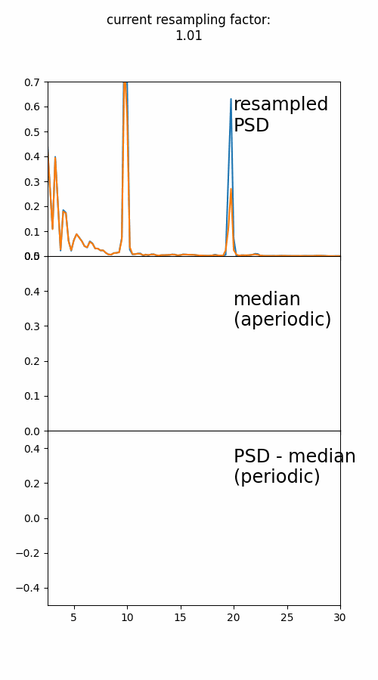
IRASA

Slide 12
Donders Institute presentation / widescreen
General Guidelines
Font use
Large texts & titles in Times New Roman
Small texts in Arial
Color use
Try to work within the Donders Color Scheme as much as possible

Slide 13
Presentation Title
Author Name

Slide 14
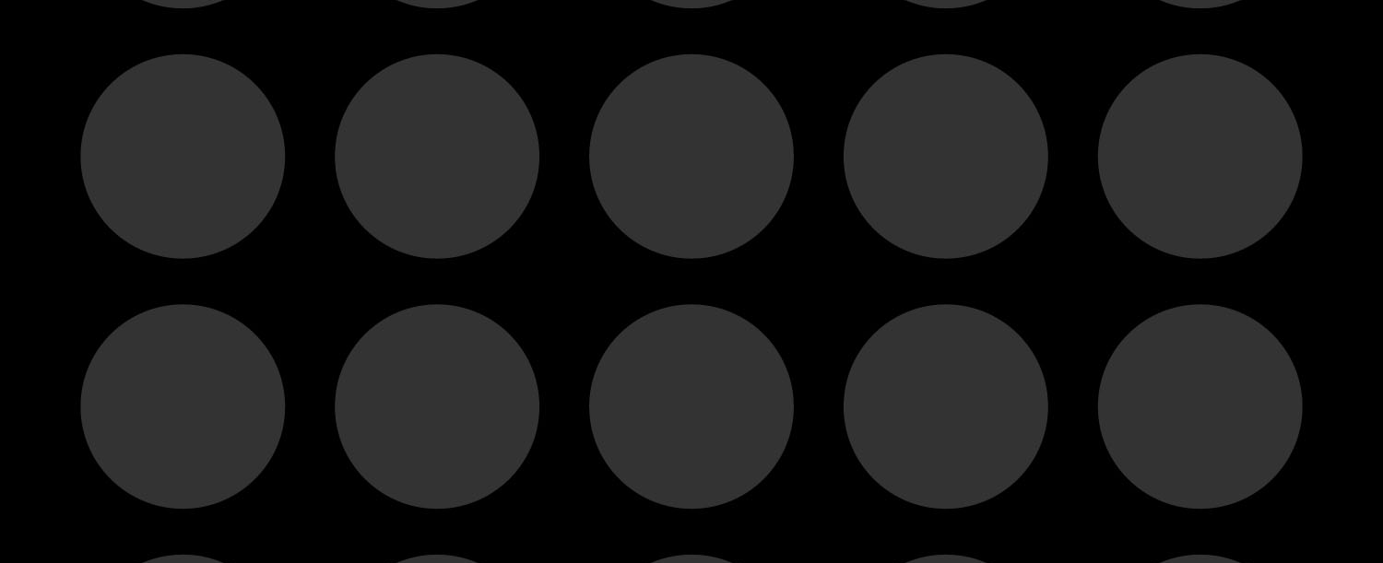
Presentation Title (+ image)
Author Name

Slide 15
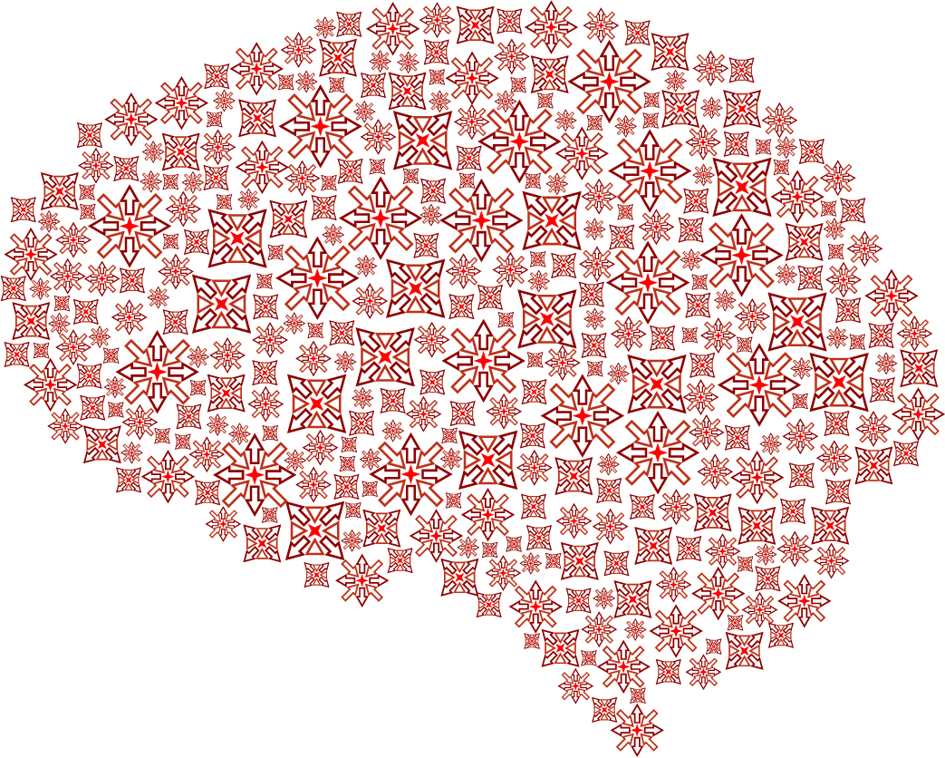
Presentation Title (+ Donders illustration)
Author Name

Slide 16

Presentation Title (example)
One image
Large texts
Small texts
Additional info like literature, references, etcetera

Slide 17

Presentation Title (example)
Two images
Large texts
Additional info like literature, references, etcetera
Small texts

Slide 18

Presentation Title (example)
Three images
Large texts
Small texts
Additional info like literature, references, etcetera

Slide 19

Presentation Title (example)
Four images
Large texts
Small texts
Additional info like literature, references, etcetera

Slide 20
Presentation Title (example)
Six images
Large texts
Small texts
Additional info like literature, references, etcetera

Slide 21
Presentation Title (example)
Plain text
Otatquis torescitibus a sit iunt arum eum conecese cusdandem doloreperrum quamust omni consequiae accae di dolest doluptas eiumquia et quamus.
Porem. Ut audicabo. Alibusd andistianit odicium, nissi delloratio corerchic te vent etusdant omnitem olestet magnis acepudant delecab iur acestorio. Gentur susdant aut que illiquat.
Dolut vel ius rest, et et laborerendae commolut lit dolum lat dolorios duntio. Explicil ipsamusam dollam, susam accaboreped exped eatibusandae esequunti omnimaios est por maiorae et am volorio rporion cone omnimpo rporenis rerro invelis re nam a aceptur?
Additional info like literature, references, etcetera

Slide 22
Presentation Title (example)
List
Item 1
Item 2
Item 3

Slide 23
Presentation Title (example)
Empty slide

Slide 24
www.example-url.com

